Slide 1
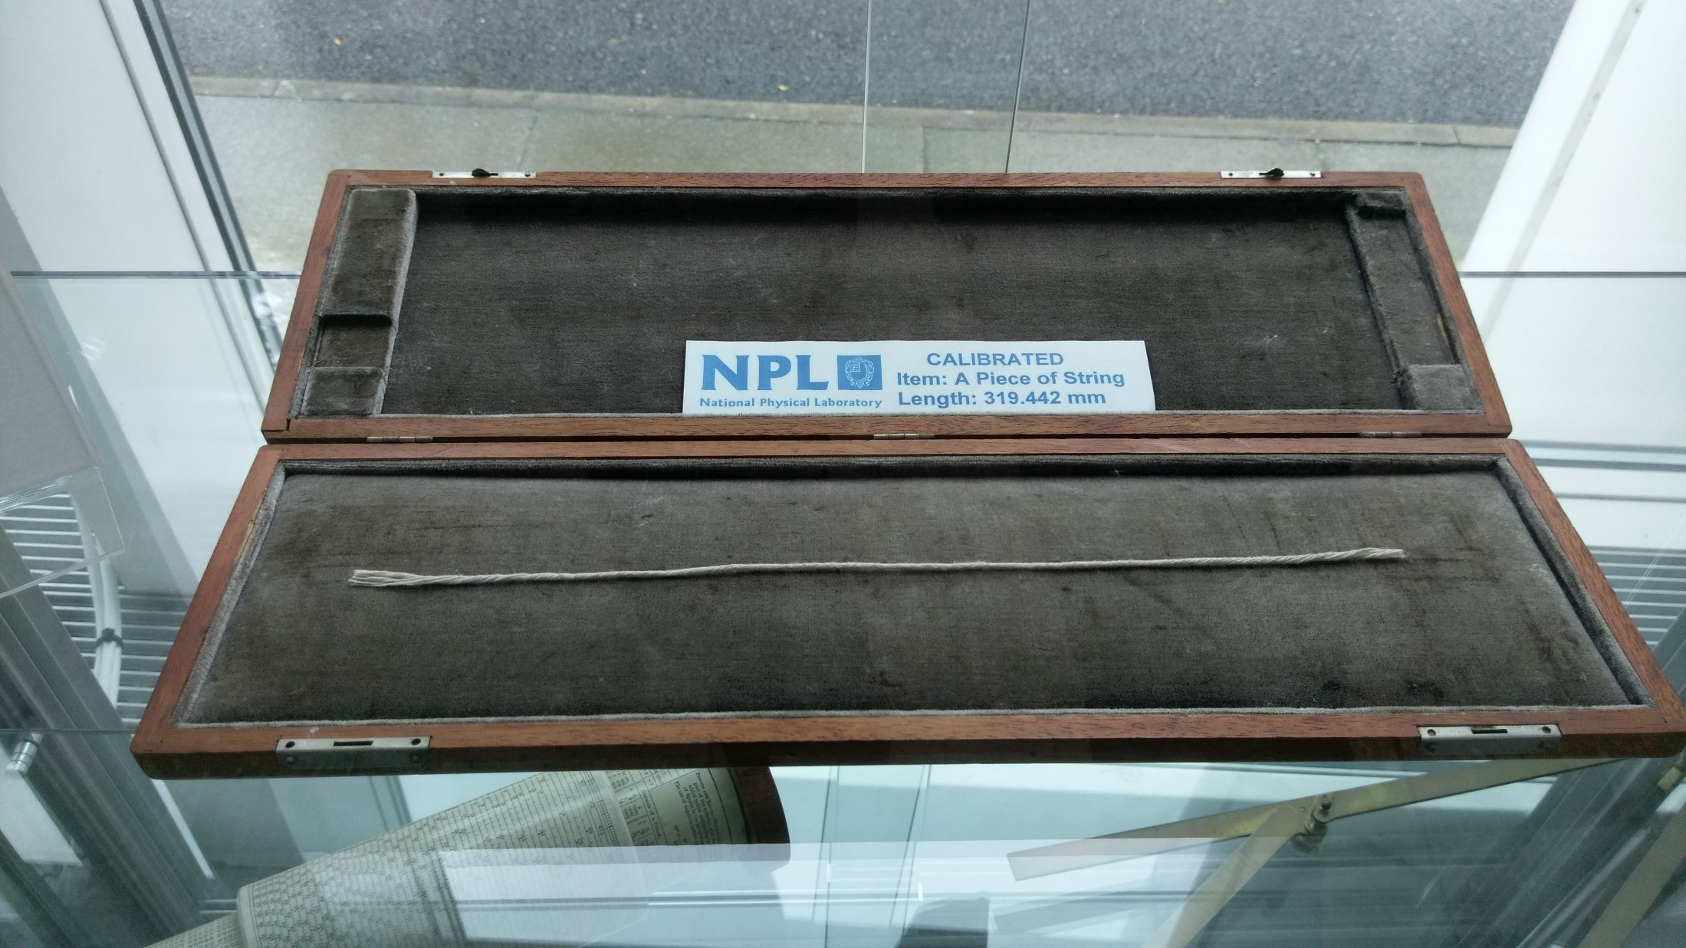
A DCAT profile for science/empirical observations
Simon J D Cox
2 October 2018
Land and Water

Slide 2
Overview
Discipline standards
X-disciplinary vocabulary for observations and sampling
Dataset and data-service metadata
Publishing machine-readable definitions

Slide 3

Discipline standards
Clinical data – HL7 – FHIR; DATS
Life sciences – OBO – OBI, ENVO; EML
Biodiversity - IUBS/TDWG – Darwin Core
Geology – IUGS/CGI – GeoSciML
Stratigraphy – IUGS/ICS – Intl. Chronostratigraphic Chart
Crystallography – IUCr – CIF
Social Sciences – DDI
…
Task Group on “Coordinating data standards amongst data unions”

Slide 4

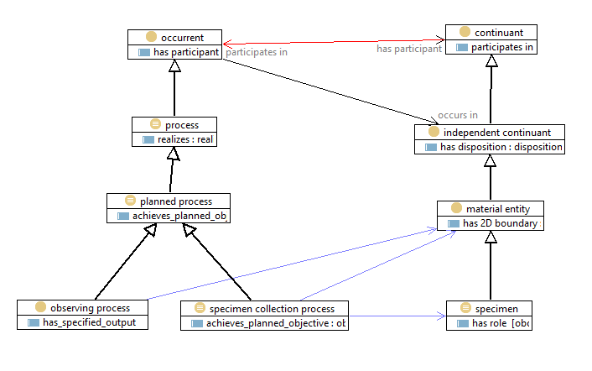
OBO - Open Biological and Biomedical Ontologies

Slide 5

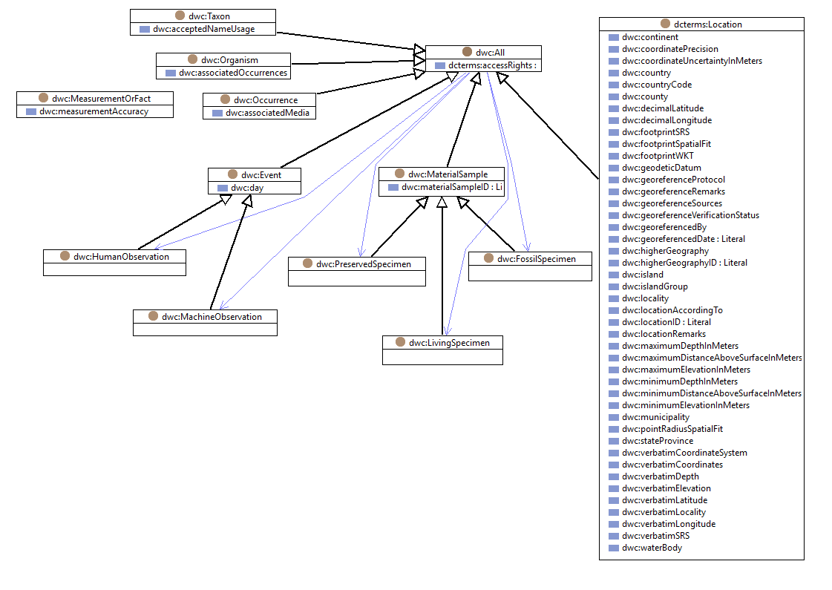
Darwin Core - biodiversity

Slide 6

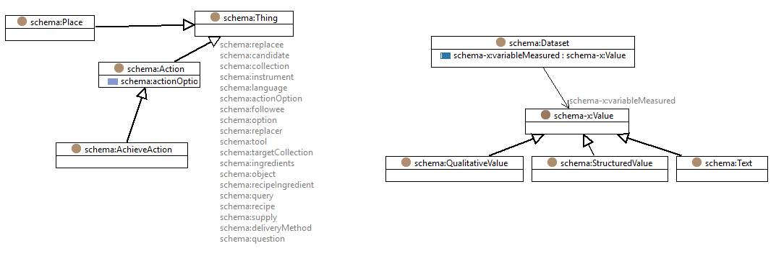
Schema.org – web search optimisation

Slide 7

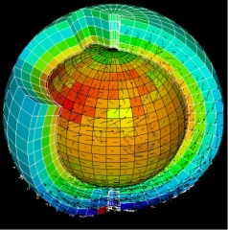

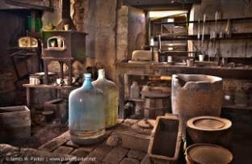
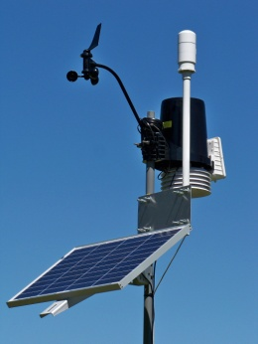
A common vocabulary for observations?
Remote sensing
Sensor
Value
Parameter
Scene
For data integration, mapping between vocabularies is a significant challenge
An Observation is an action whose result is an estimate of the value of some property of the feature-of-interest that applied at the stated phenomenon-time, obtained using a specified procedure, completed at the recorded result-time
Earth science
Algorithm, code, simulator
Model, field
Variable
Volume, grid
Metrology
Instrument
Value
Measurand
Sample
Chemistry
Instrument, analytical process
Analysis
Analyte
Sample
Environmental monitoring
Gauge, sensor
Value, time-series
Parameter
Station
Observations & Measurements
procedure
result
observed property
feature of interest
Notes:
This slide was originally developed for the 2013 Leptoukh Lecture.
Might need to kill the animation and just make the main points over it.
Different disciplines use different words for the same things
O&M provides a standard, domain-neutral terminology
Reduces ambiguity
Increases interoperability

Slide 8
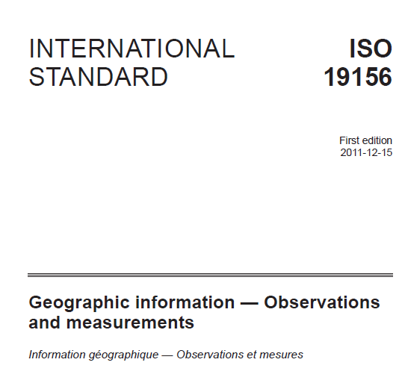

Cox, OGC Abstract Specification – Topic 20: Observations and Measurements 2.0
Notes:
Working in OGC we developed a ‘standard’ vocabulary for fine-grained descriptions of (or metadata for) Observations and Measurements.
It was published in 2011 as an ISO standard
The core story is this: an information model, specified in UML, which defines a small terminology to describe the key aspects of an observation.
The terminology is deliberately domain neutral, and the terms all have (different) local equivalents in different domain applications.
A key trick was to recognize that the observation is a separate concept to the observation-result, and that by also treating the descriptions of the procedure and the feature of interest separately, we get a very general framework which covers

Slide 9
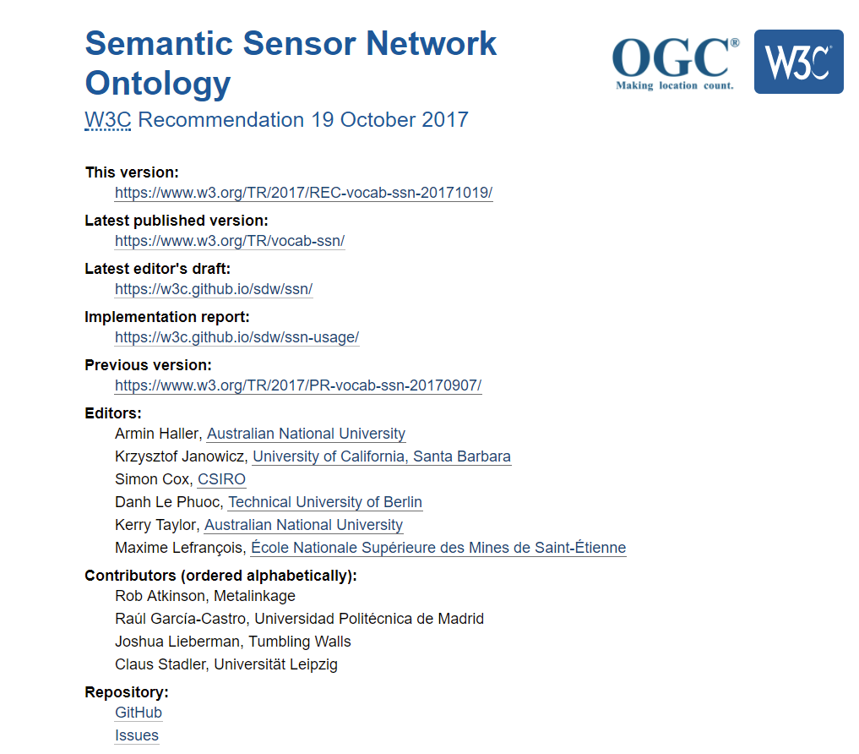
Now also a W3C vocabulary (2017)
Notes:
Now it has been formalized as an OWL ontology and published as a W3C Recommendation – October 2017

Slide 10
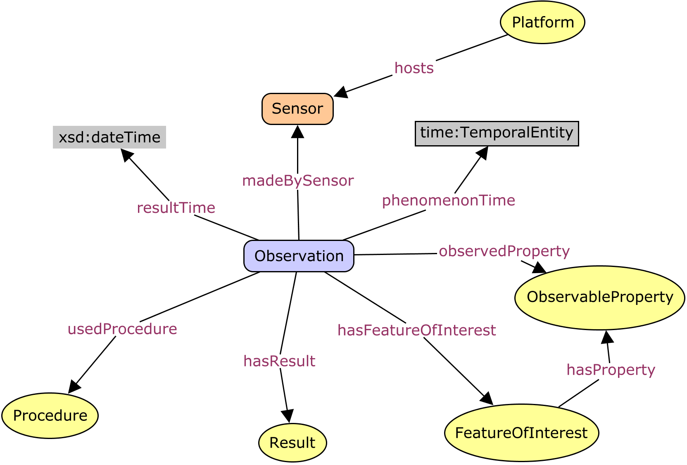
“Observation” = Act of observation
Phenomenon-time = time result applies to feature
Result-time = time result became available
Sensor observations: result-time ≥ phenomenon-time
Forecasts: result-time < phenomenon-time
Archeology, Geology, Cosmology: result-time >> phenomenon-time
https://www.w3.org/TR/vocab-ssn/
Notes:
Observation model – as O&M except Procedure (plan, protocol) and Sensor (implementation) are separated
Phenomenon-time != result-time – allows use of model for forecasting, estimation of geological properties in deep past

Slide 11
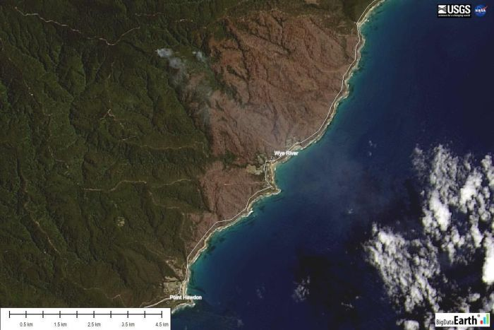
Many types of result
1.76m Scaled number
(-37.908, 145.029) epsg:4326 Vector, Tuple
Array, Image, Field
“Silurian” ISC 2017 Word or concept, classifier
“poor” {reference} Assessment
“false” Boolean
Value of result is tied to a reference system

Slide 12
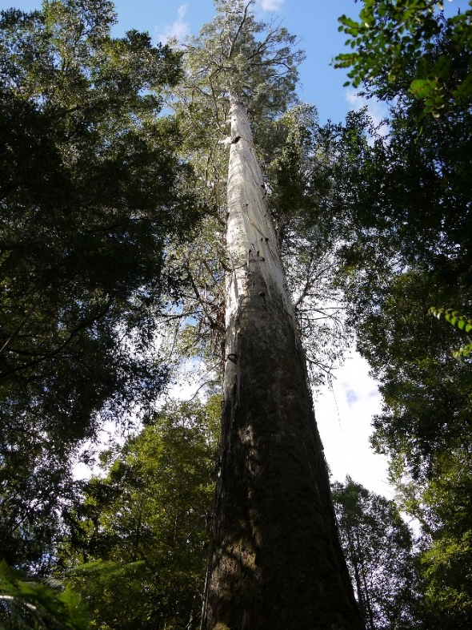
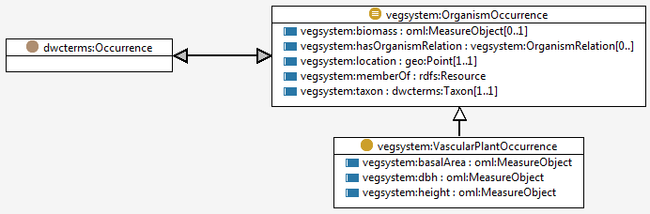
Domain model
Feature type
VascularPlantOccurrence
Characteristic properties
height
dbh
taxon
location
Property values
= 91 m
= 1.5 m
= Eucalyptus regnans
= -42.72, 146.81
A feature type is defined by a set of characteristic properties
A feature instance is defined by the values of its properties
Notes:
Skip if short of time

Slide 13
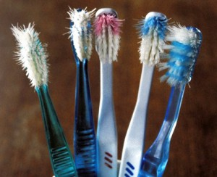
One vocabulary to rule them all?
No way
Separate disciplines have their specific requirements, community, prerogative
Each community focuses on specific elements of empirical science

Slide 14
“Observation” = Act of observation
Standard terms, encapsulate the complexity
instruments and sensors
observable-properties
protocols and procedures
Conceptual model of the application-domain including the object types (features)
Notes:
The general model can be specialised for use in a specific domain, by defining domain specific feature types and lists

Slide 15
One vocabulary to rule them all?
No way
Separate disciplines have their specific requirements, traditions, prerogative, community
Each focuses on specific elements of empirical science
This model labels the boxes where specialists focus their work
Common high-level vocabulary makes mapping between disciplines easier, not frictionless

Slide 16
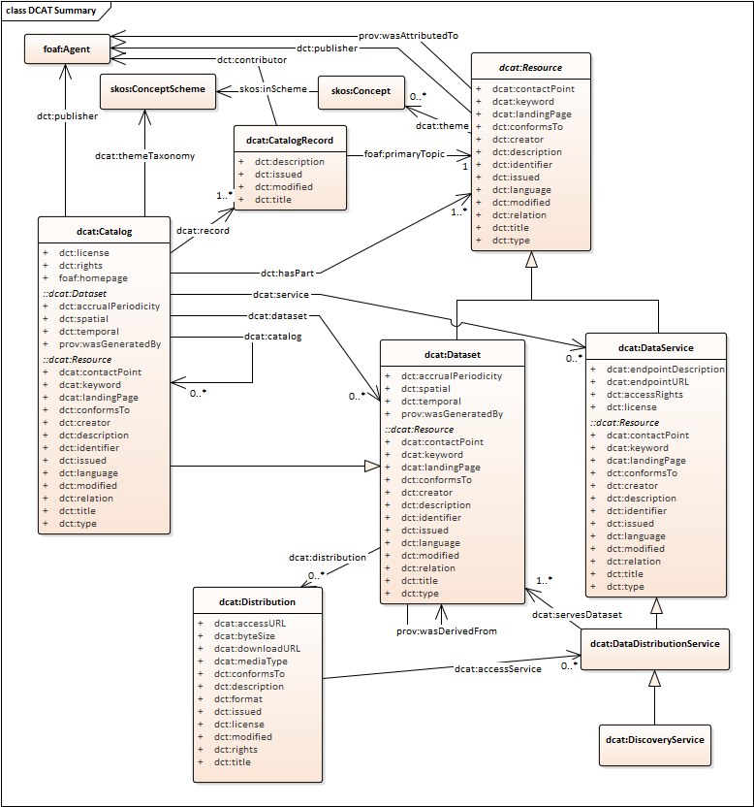
DCAT
W3C Dataset catalog
https://w3c.github.io/dxwg/dcat/

Slide 17
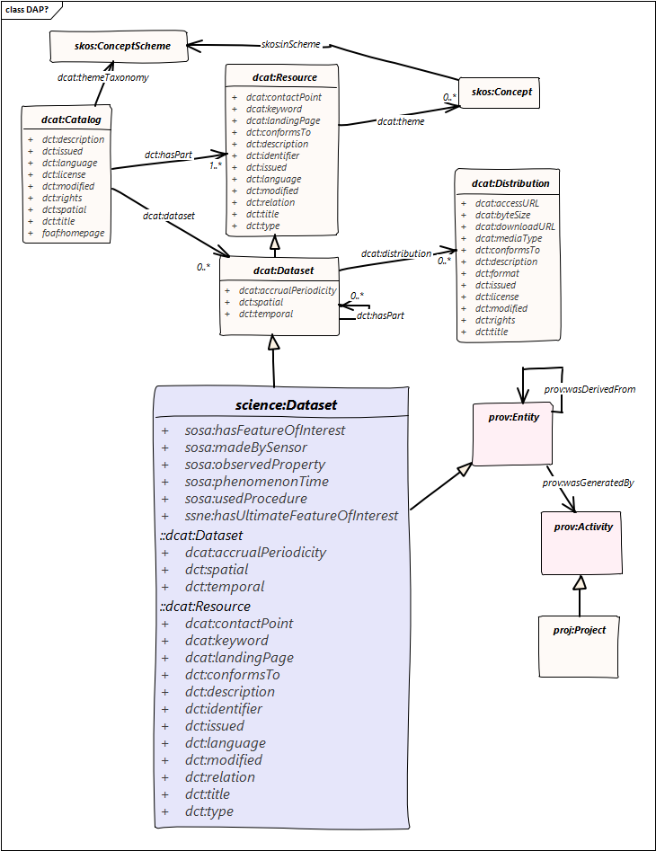
DCAT science profile?
W3C ontology mashup:
Controlled vocabularies
Observation properties
Project context

Slide 18
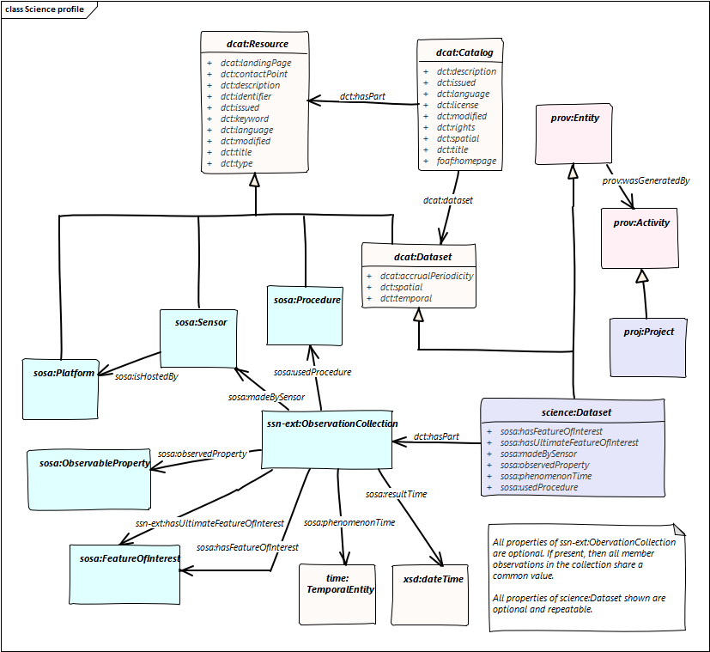
DCAT Science profile
Collections of Observations

Slide 19
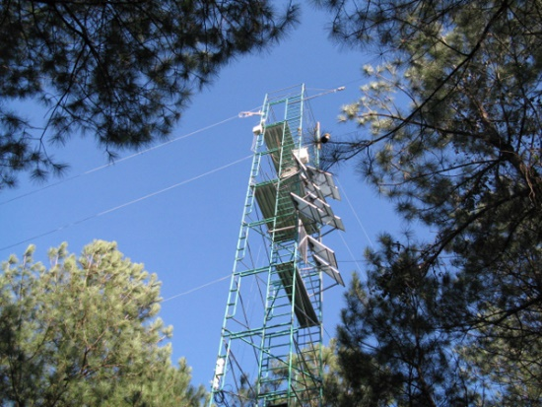
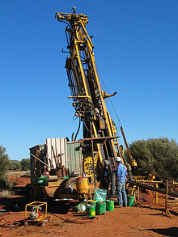

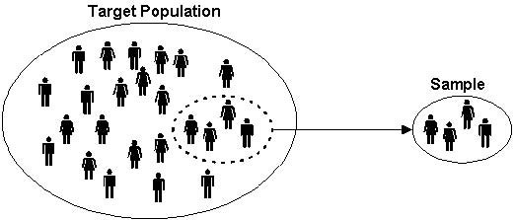

Sampling

Slide 20
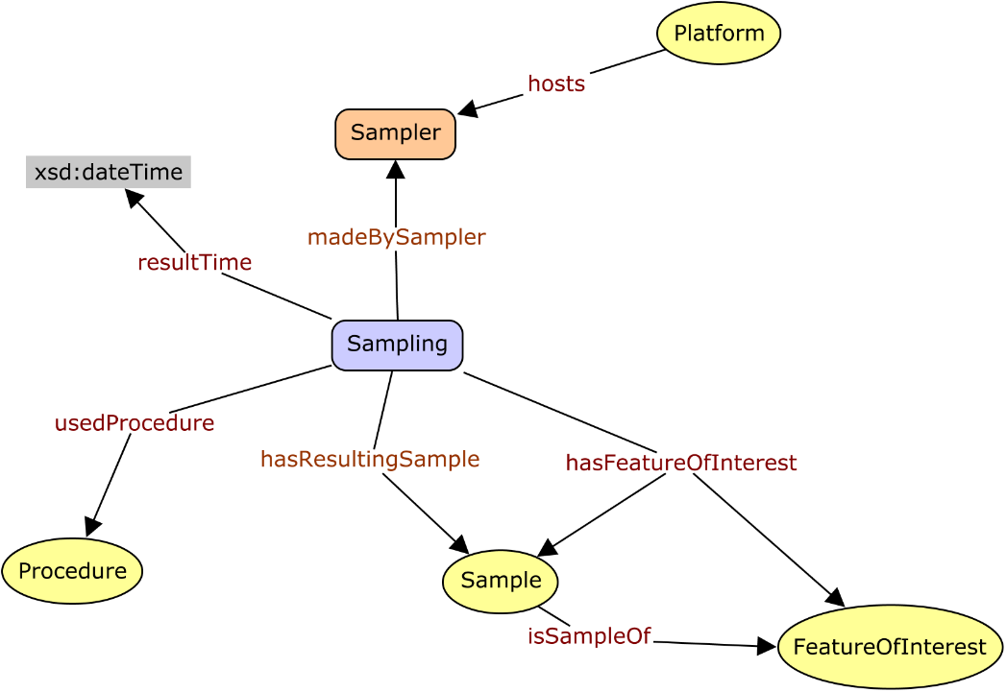
Sample = result of Act-of-sampling
A ‘sample’ is a thing or subset which is intended to be representative of a larger thing or set …
… created or selected for the purpose of making observations to determine the value of one or more properties, traits or qualities of the larger thing
The essential property of a sample is the 'is-sample-of' relationship with the larger thing.
https://goo.gl/KBvkgW
Notes:
Sampling is core part of scientific observations
Definition supports all kinds of sampling, including statistical sampling of a population
Essential property captures sampling intention – to be representative of a bigger thing

Slide 21
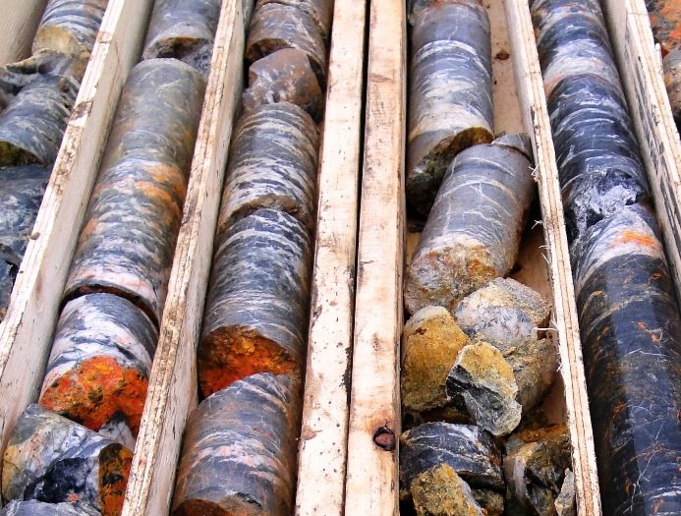

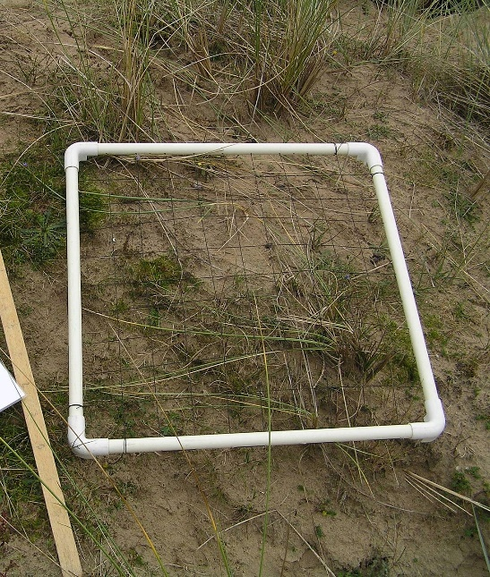
Types of sample
A material sample or specimen is typically selected to allow ex-situ observations
A statistical sample or subset is a specified number of individuals from a population
A spatio-temporal sample may have the same dimension but a smaller extent than the thing which it represents,
or a lower topologic dimension than the thing which it represents

Slide 22
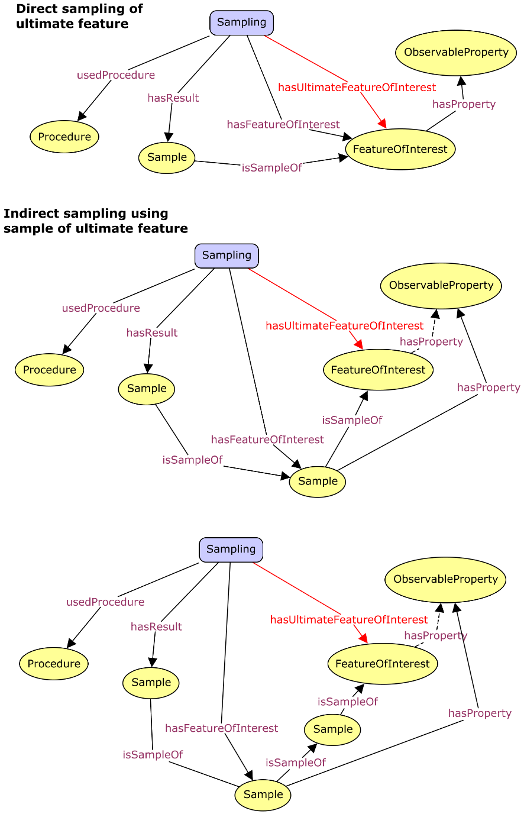
Sampling chains
Similar patterns apply to samples
https://w3c.github.io/sdw/proposals/ssn-extensions/

Slide 23
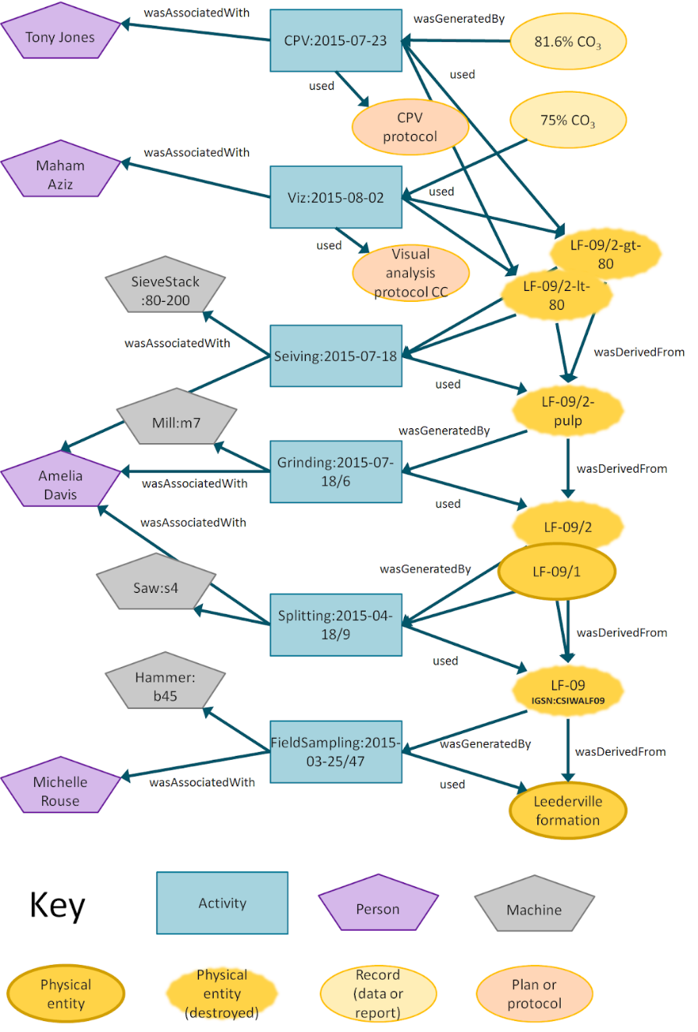
Sample preparation
Details of sample preparation chains can be recorded using PROV-O
https://www.w3.org/TR/prov-o/
Provenance-of-things - https://goo.gl/HeVkXp

Slide 24
Thank you
Land and Water
Simon Cox Research Scientist
t +61 3 9545 2365
e simon.cox@csiro.au w www.csiro.au
Land and water

Slide 25
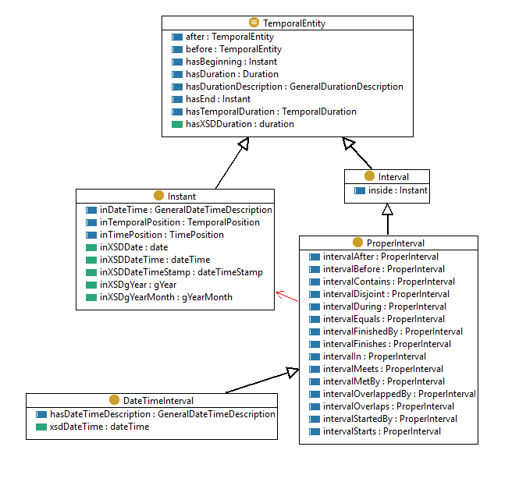
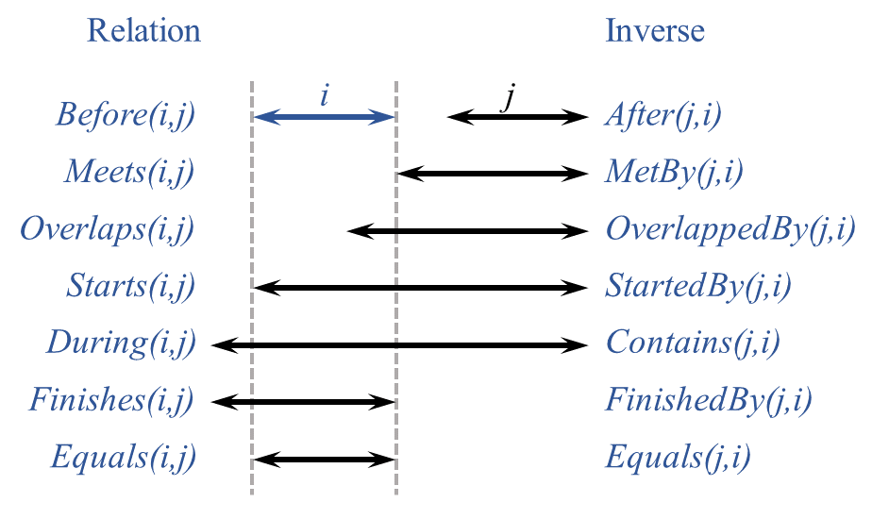
OWL-Time
https://www.w3.org/TR/owl-time/

Slide 26
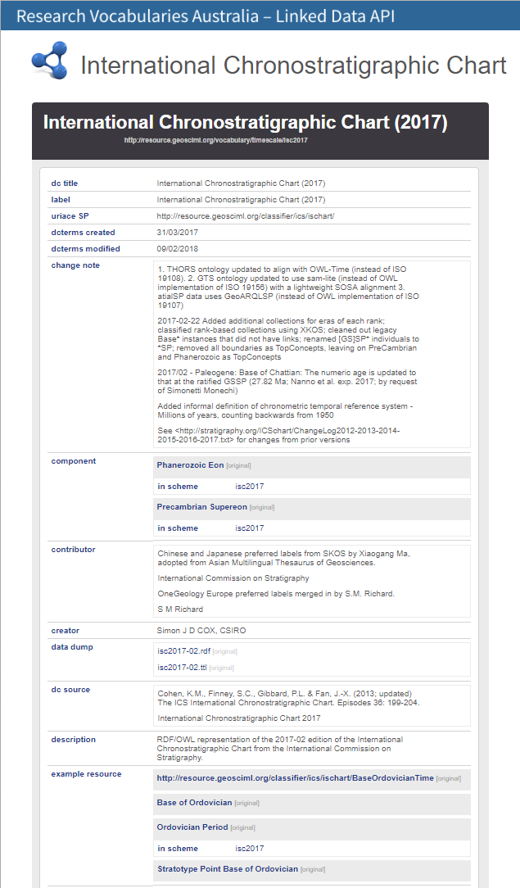
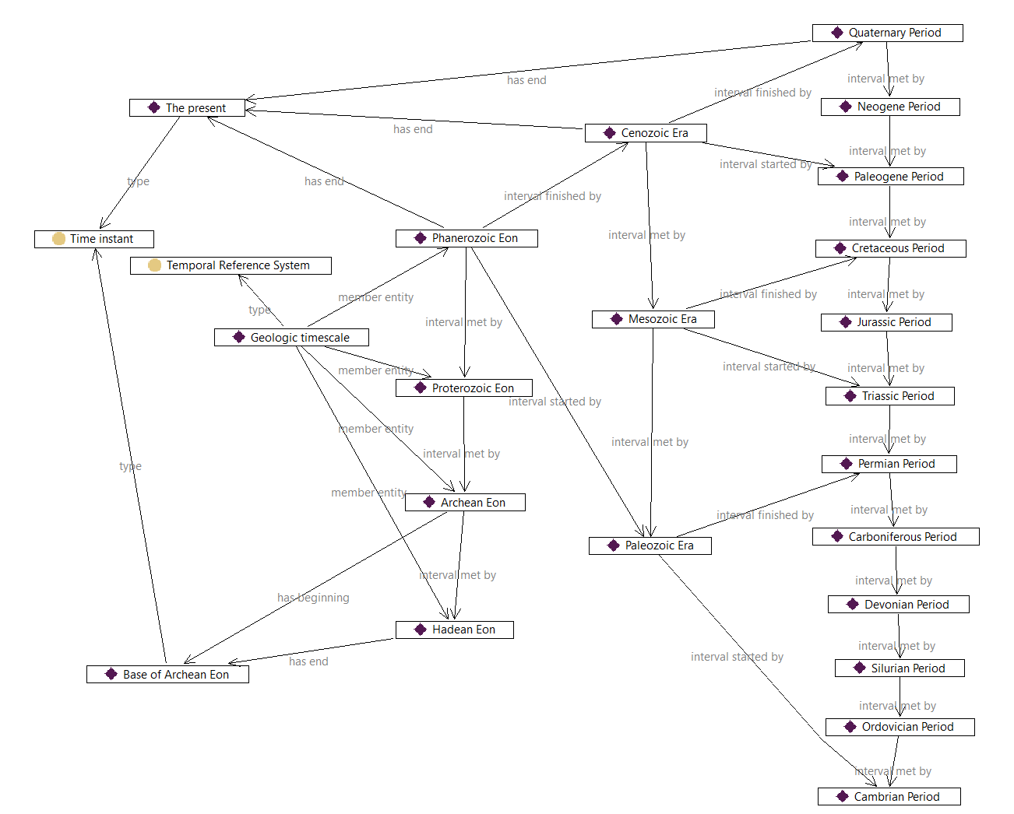
Geologic timescale
https://doi.org/10.25919/5b4d2b83cbf2d
http://resource.geosciml.org/vocabulary/timescale/isc2017

Slide 27
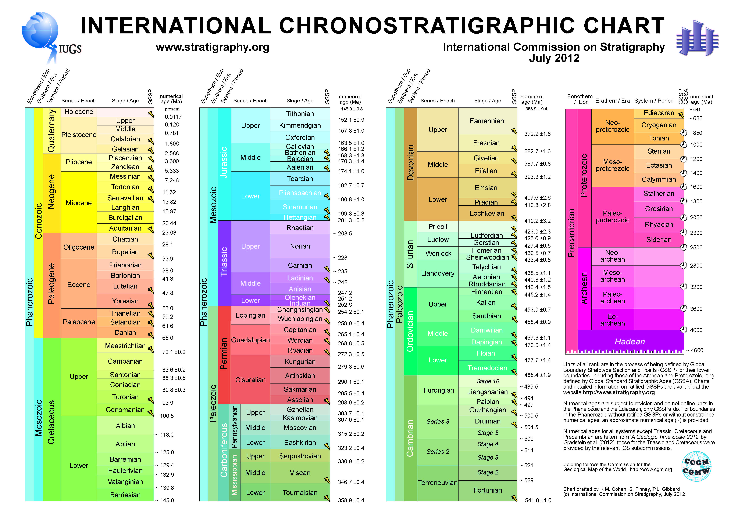
PDF image - also not machine-processable!

Slide 28
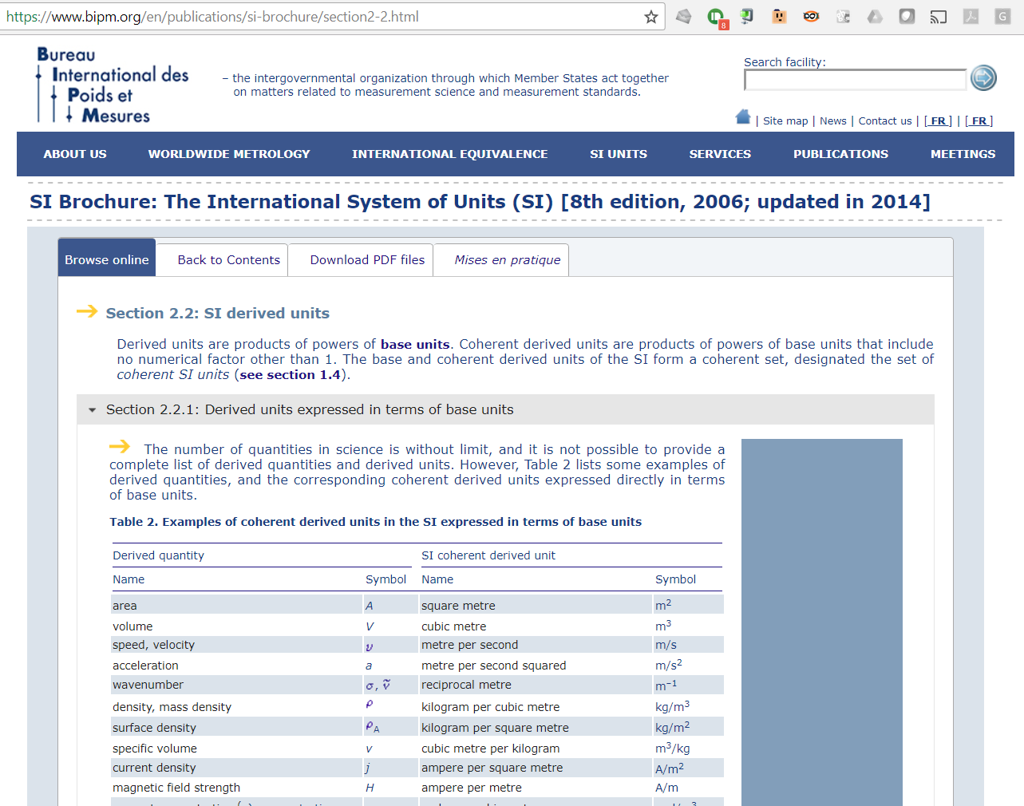
A web page – not directly interpretable ☹

Slide 29
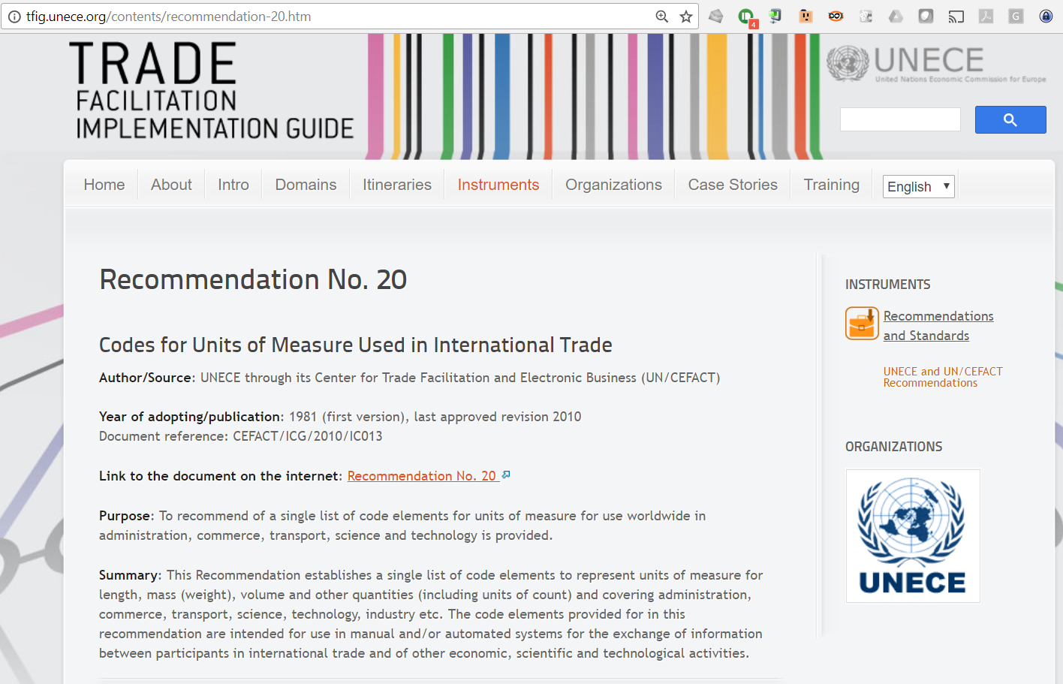
PDF + Excel table (better, but still not Linked Data)

Slide 30
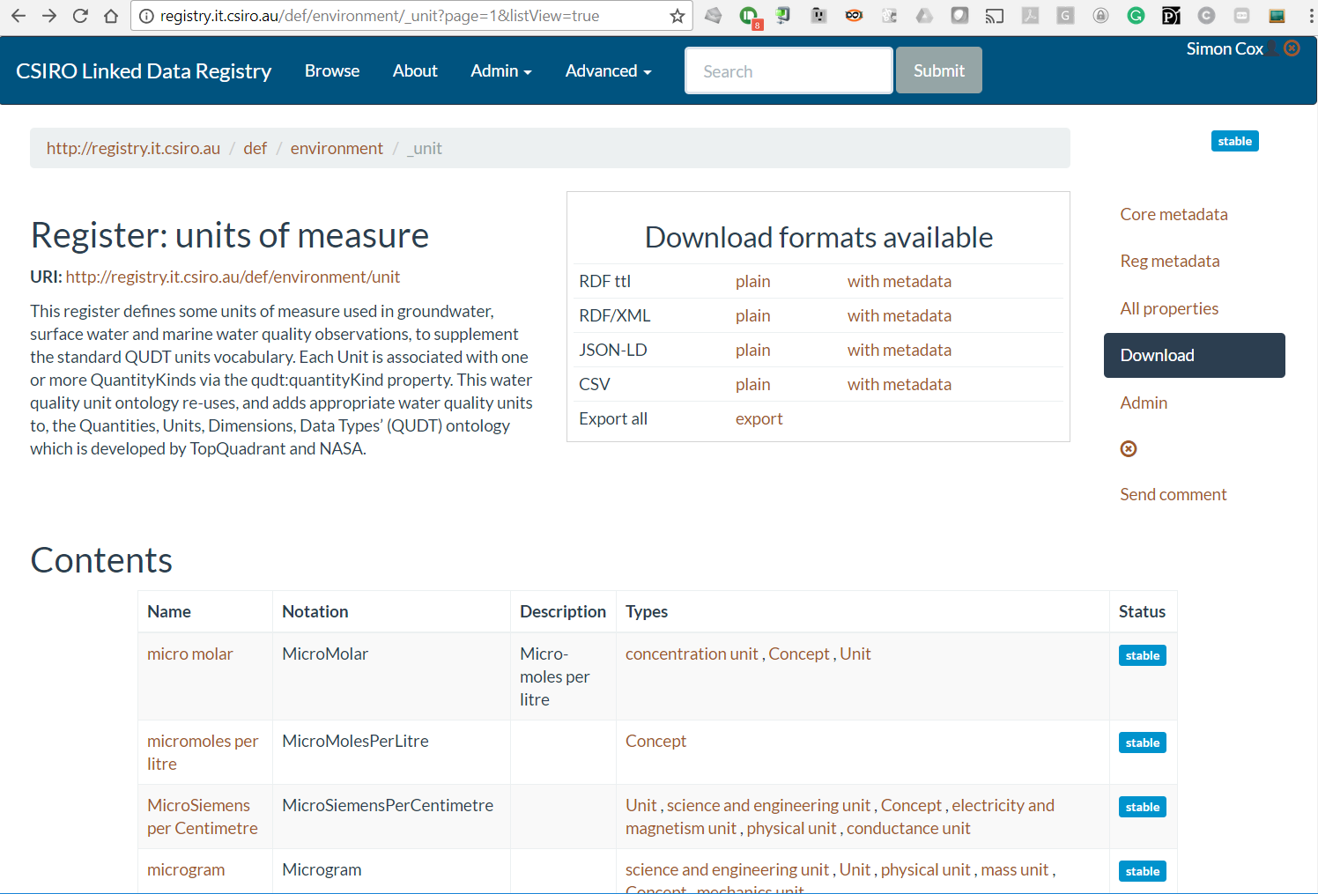

Slide 31
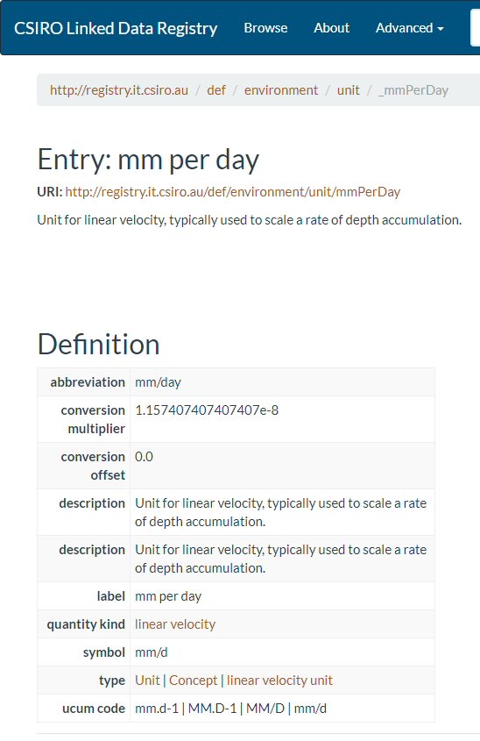
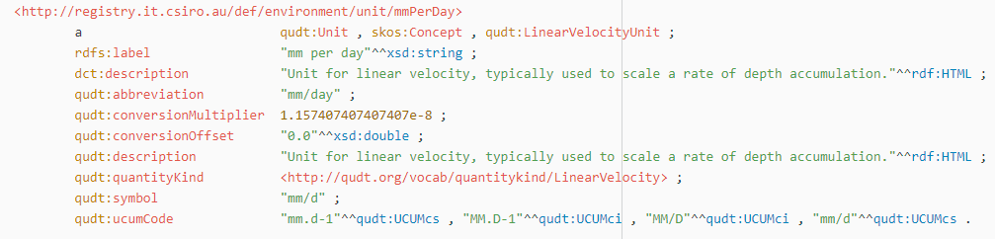
What does ‘machine readable’ look like?
A URI for each term
Structured values, references to other vocabularies

Slide 32
Example/Opportunity?
Geodetic reference systems
British National Grid
WGS84
GDA94, 2016, 2020
Various state datums …
Critical business requirement
European Petroleum Survey Group – EPSG (now OGP)
→ EPSG database
De-facto standard
Recognised by ISO TC/211
Access database for download
OGC Registry
… CODATA?

Slide 33
Summary
W3C ontologies - discipline-neutral, but science-friendly
Potential bridging vocabularies between disciplinary vocabularies
Term definitions can be machine-readable, in linked data

Slide 34
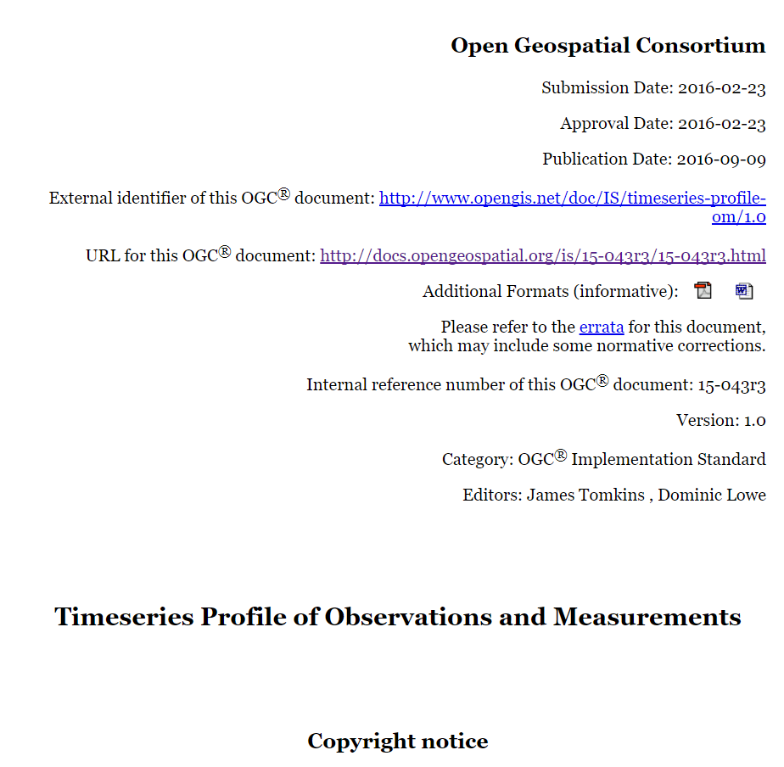
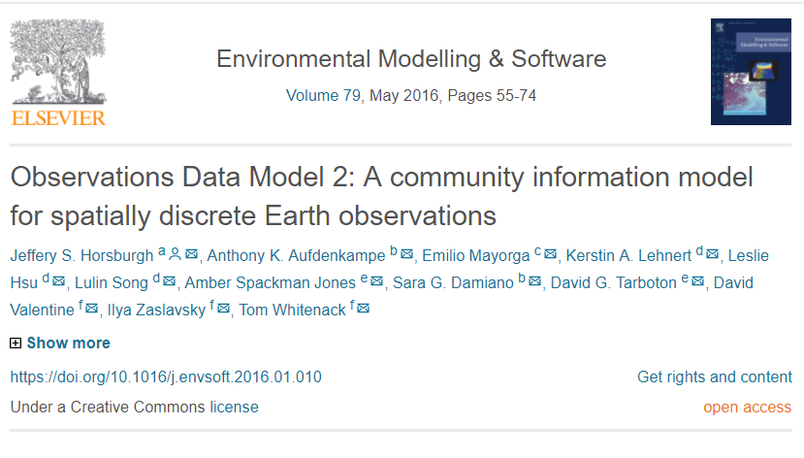
Implementation work

Slide 35
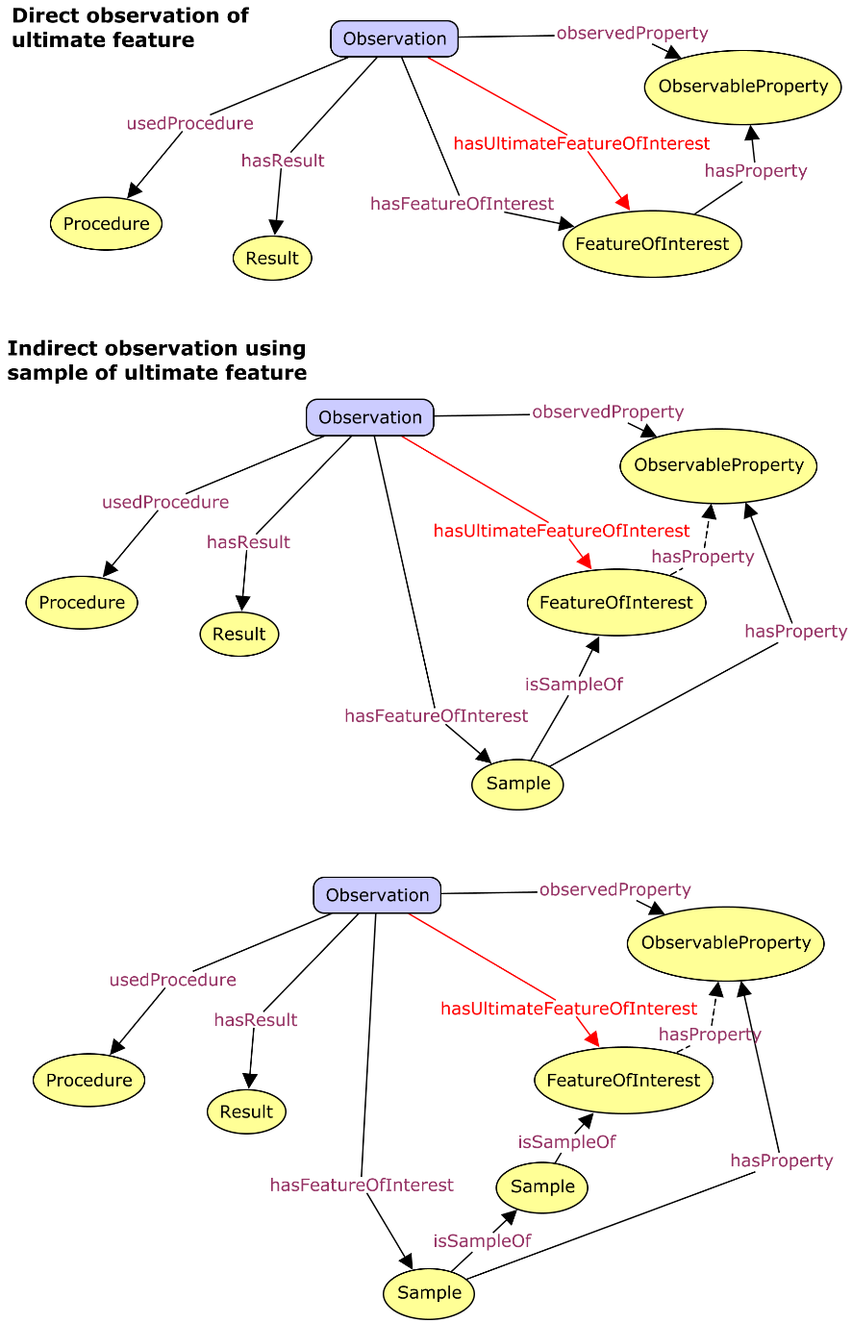
Indirect observation
While sometimes the proximate feature of interest is also the ultimate feature of interest
most observations are on samples
and some samples are several steps removed from the ultimate feature of interest
https://w3c.github.io/sdw/proposals/ssn-extensions/

Slide 36
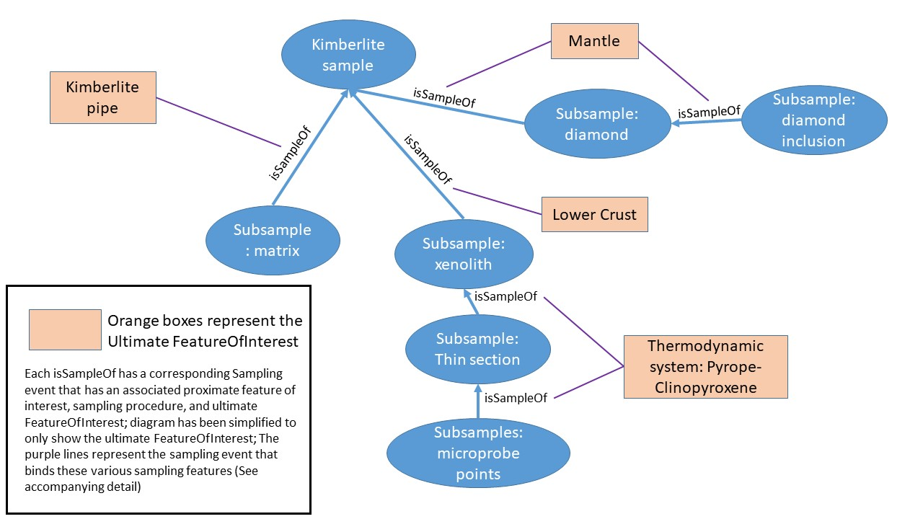
Same samples may relate to different UFoI

Slide 37
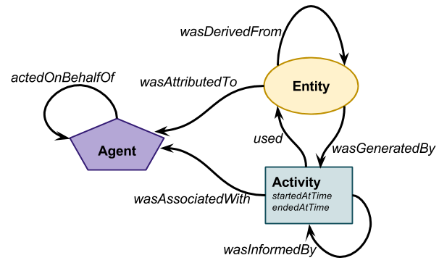
Core PROV
Process-flow model
Developed primarily for datasets, data products, reports
T. Lebo, S. Sahoo, D.L. McGuinness, PROV-O: The PROV Ontology, (2013). http://www.w3.org/TR/prov-o/ (accessed February 13, 2014).

Slide 38
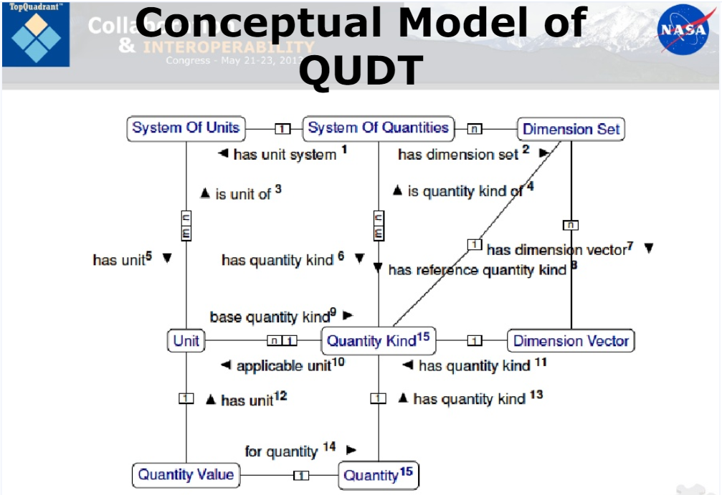

Slide 39
